Slide 1
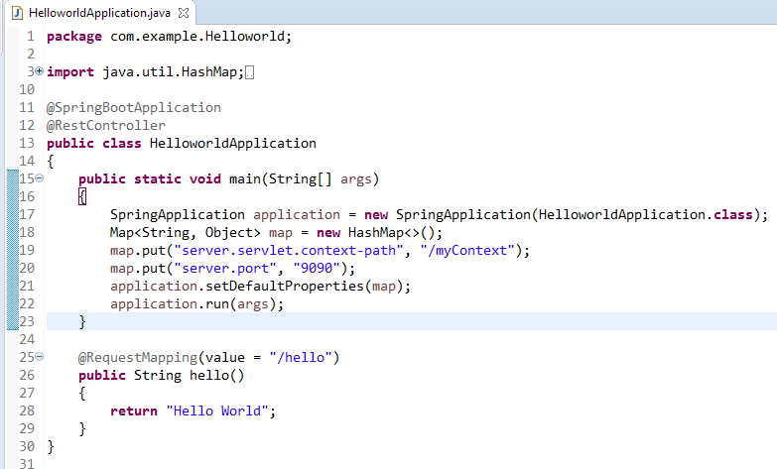
Spring Boot – How to Change Default Context Path Programmatically?
SpringApplication has a method as setDefaultProperties() that is used to change spring boot default properties. Suppose we want to change context path and default port then we need to create a Map and put server.servlet.context-path key with value of desired context path name using prefix ("/")
To change server port we need to put server.port key with desired port value.

